Slide 1

SIWES PRESENTATION BY ENOCH CHISOM EZE 20/7056
MAY - NOVEMBER 2023
1

Slide 2
TABLE OF CONTENT
INTRODUCTION
COMPANY’S PROFILES
WORKDONE
EXPERIENCE GAINED
VALUE ADDED
CONCLUSION

Slide 3
INTRODUCTION
Student Industrial Work Experience(SIWES) was established in the year 1973 to solve the problem of lack of adequate proper skills for employment of tertiary institution graduates by Nigerian Industries.
The scheme serves as a smooth transition from classroom to the world of work and further helps in the application of knowledge.
The scheme also provides students with the opportunity of acquainting and exposing themselves to the experience required in handling and managing equipment and machinery that are usually not made available in their institutions.

Slide 4

COMPANY’S PROFILES
De-Swipht Qoncepts and Resources is an integrated organization that comprises of several sister companies, each specializing in several areas of expertise which are committed to empowering through data, sustainability, and logistics:
PQPlus: This is a training entity focused on training individuals in the skill of data analytics, employing software such as Microsoft Excel, Microsoft Power BI, etc.
Swiphtgreen: This entity specializes in eco-friendly solar energy solutions and offering training in the skill of solar systems design and implementations.
Swipht Logistics: This entity is a full-service logistics provider for domestic and international needs.
Collective Impact: Dynamic group advancing industries for positive change.

Slide 5
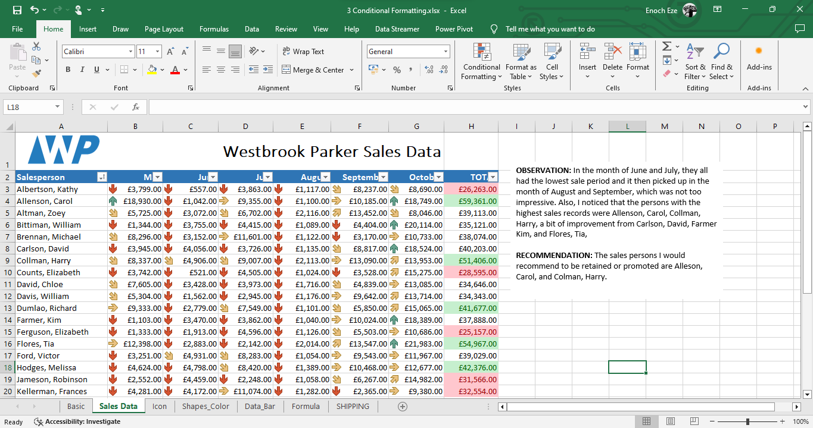
WORKDONE
A simple data analysis for a company sales data sheet, outlining my observations and recommendation. The purpose of this simple project was to gain preliminary knowledge on data analysis and critical thinking.

Slide 6
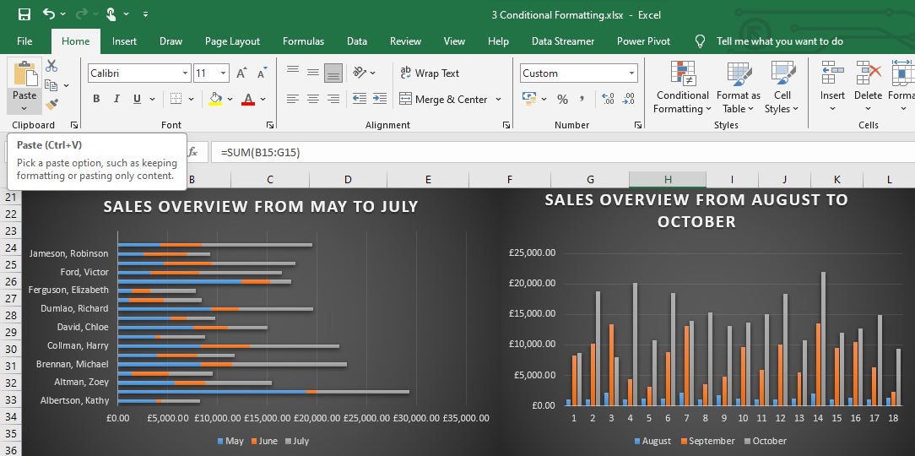
WORKDONE
A simple visual illustration of a company’s sales data while getting preliminary knowledge on the skill of data analysis.

Slide 7
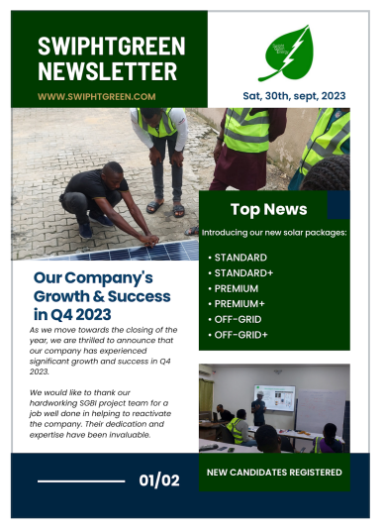
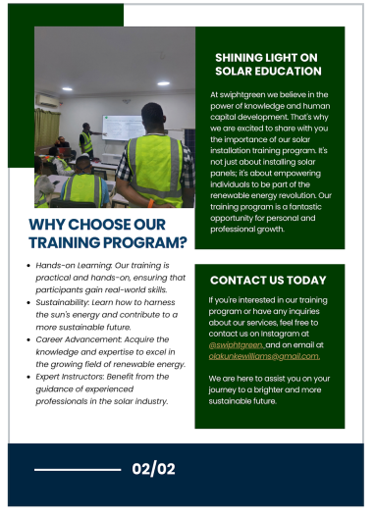
WORKDONE
Designing of newsletters for the solar company, which were released to the internet monthly as a marketing strategy to generate sales.

Slide 8
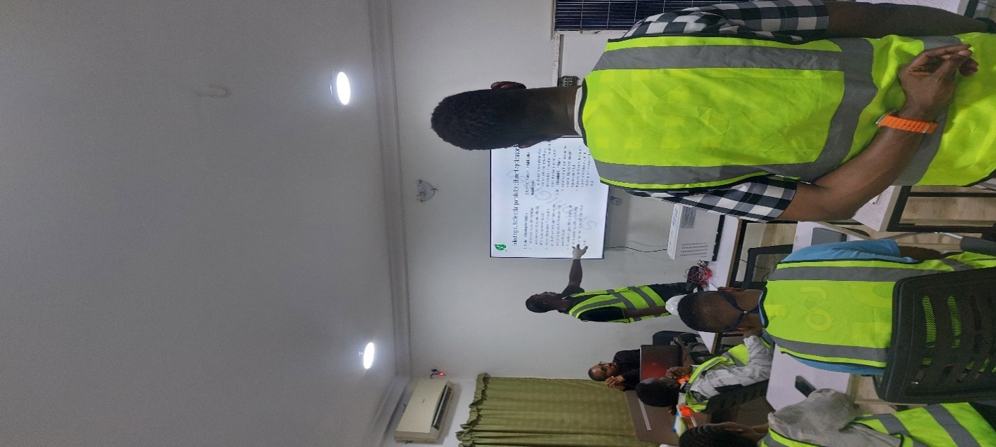
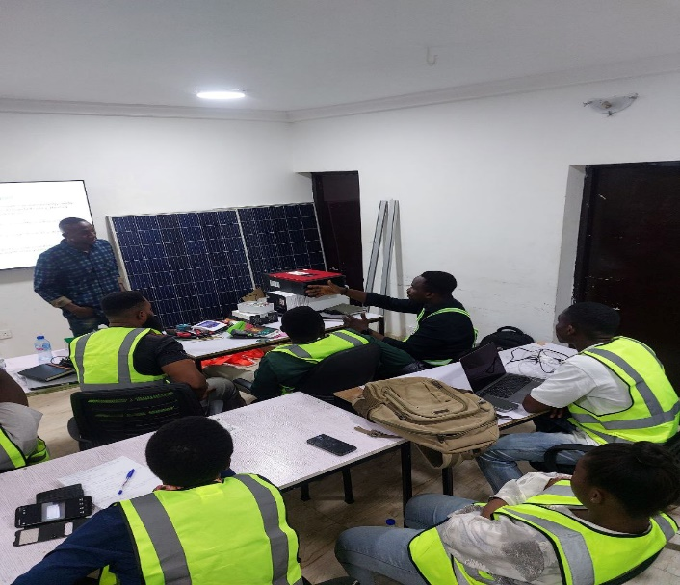
WORKDONE
Activated candidates for Swiphtgreen, which are results of successfully onboarding the targeted number of clients through strategic marketing.

Slide 9


WORKDONE
Designing of flyers used to run ads for Swiphtgreen.

Slide 10
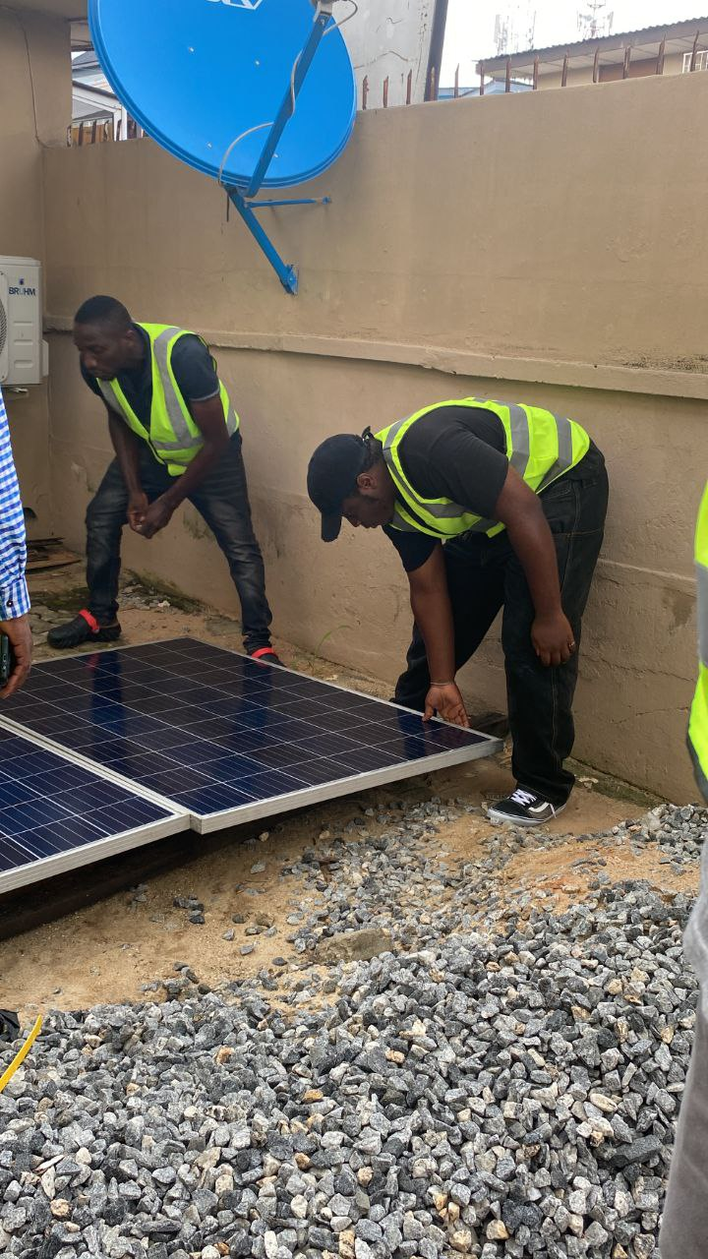
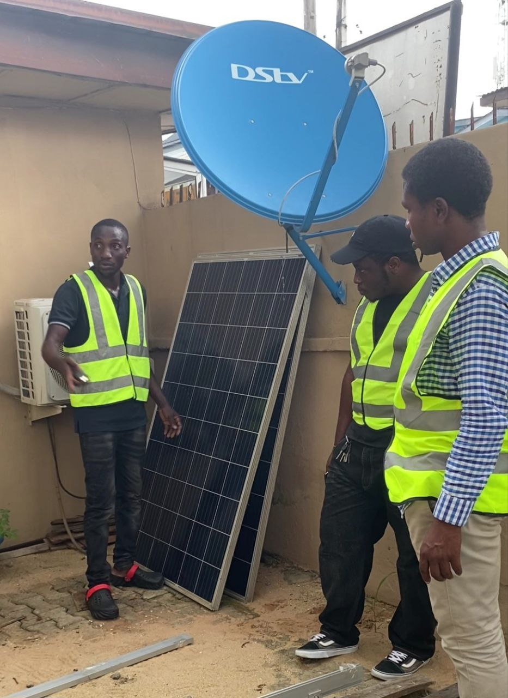
WORKDONE
Solar panel installation and connection.

Slide 11
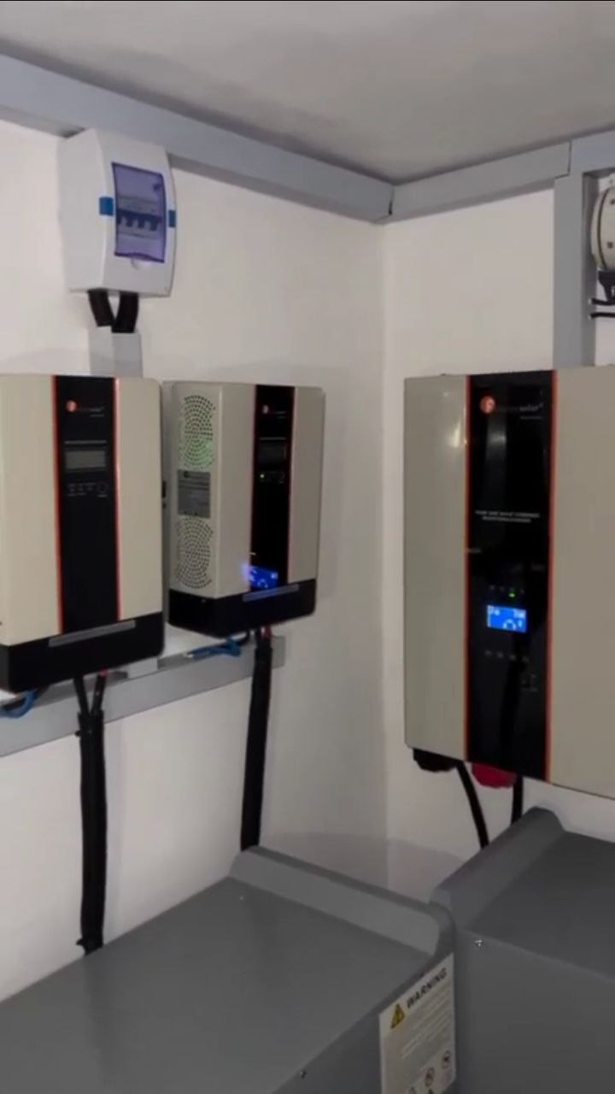
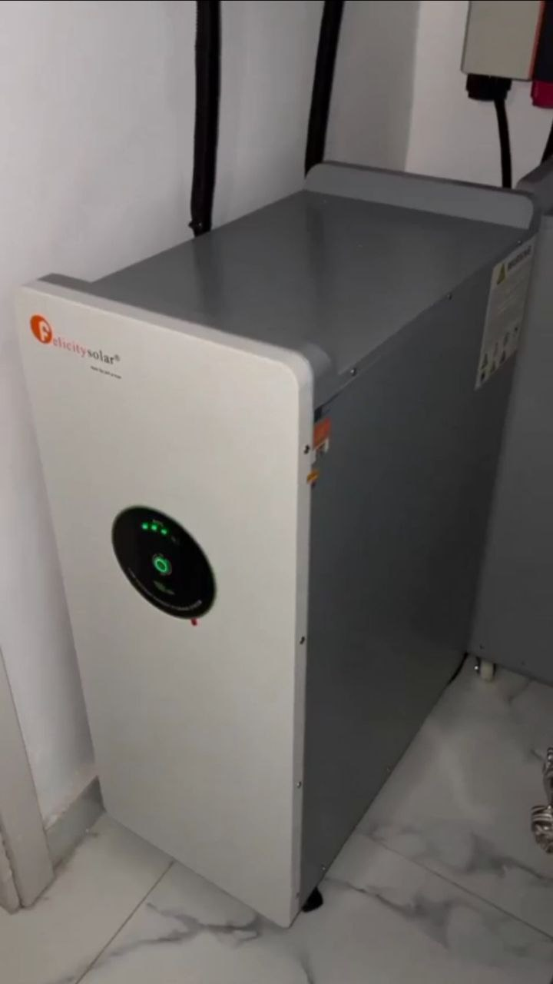
WORKDONE
Installation of inverter systems after sizing.

Slide 12
EXPERIENCE GAINED
Work Experience: I have learnt how to put my knowledge and skills I have developed into practice.
Design/Editing Skills: At De-swipht Qoncepts and Resources, I was exposed and challenged to learn a varied number of design and editing software for creating design and video content to run ads and in turn, generate sales for the sister companies. Such include Canva, Photoshop, Capcut, premiere pro, etc.
Communication Skills: While working as a sales, marketing and communications manager, I have learnt how important good communication is, to colleagues, clients, and so on
Listening Skills: I have learnt the benefits of taking feedbacks, both positive and negative ones as it is essential for the future.
Ethical Rules: I have totally understood the workspace culture, (corporal behavior, certain documentation, and so many more unique rules).
Teamwork: I learnt how to work with a team, both in the sales department and in the solar field.
Preliminary Knowledge: I gained preliminary knowledge on data analytics using MS Excel (Filtering, sorting, shortcuts, etc.), and preliminary knowledge on solar systems design, implementation, and troubleshooting.
Sales: I understood the concept of sales and how to use available data (conversion rate, impressions, etc.) to project future profit and give a revenue forecast.

Slide 13
VALUE ADDED
Generated sales for both sister companies (PQPlus and Swiphtgreen)
Assisted with the installation of several new application software in the company laptops as well as troubleshooting.
Assisted in the mounting and installation of solar panels in a varied number of sites in the state.
Assisted in the installation of inverter systems in the solar company.
Developed ads content for the company using flyers, newsletters, and edited videos.
Updated the company CRM record with more data as a result of the sales I generated.

Slide 14
CONCLUSION
The SIWES program has provided me with the opportunity to have a feel of the actual corporate world. The ability to work under the pressure of deadlines, relating with fellow and senior colleagues, communication with clients of different personalities, being able to proffer solutions to pressing problems, and a clearer view to the importance and relevance of technology in the immediate society.
THANK YOU

